Slide 1
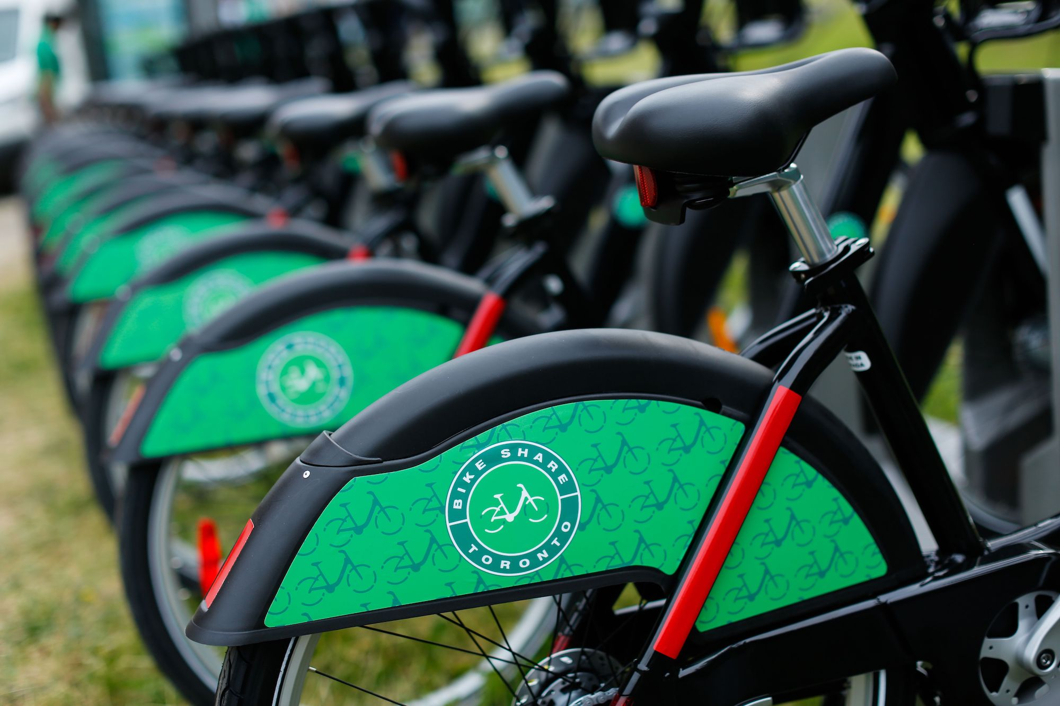

Toronto
Bike-Sharing
Demand Prediction
Group 7
Inez Suyono
Ivan Coelho
Shohesh Patel
Dana Du

Slide 2



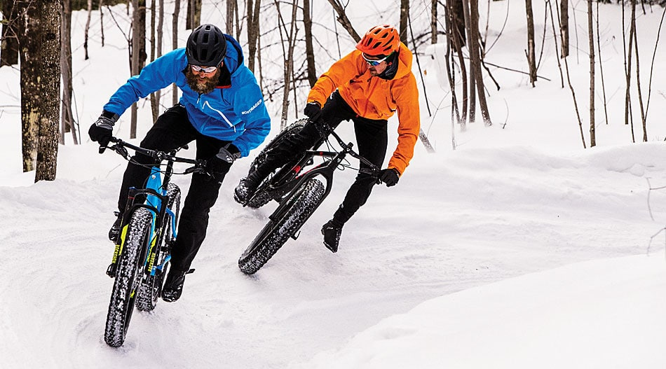

Overview of The Project
Correlation(s) between the different types of weather conditions and the demand on bike sharing

Slide 3


Project Scope
Location
Time
Toronto - Ontario- Canada
3 Years
1 Jan 2019 to 31 Dec 2021

Slide 4










Tools
Visualization
Software
Library & Language

Slide 5

Data & Database

Slide 6

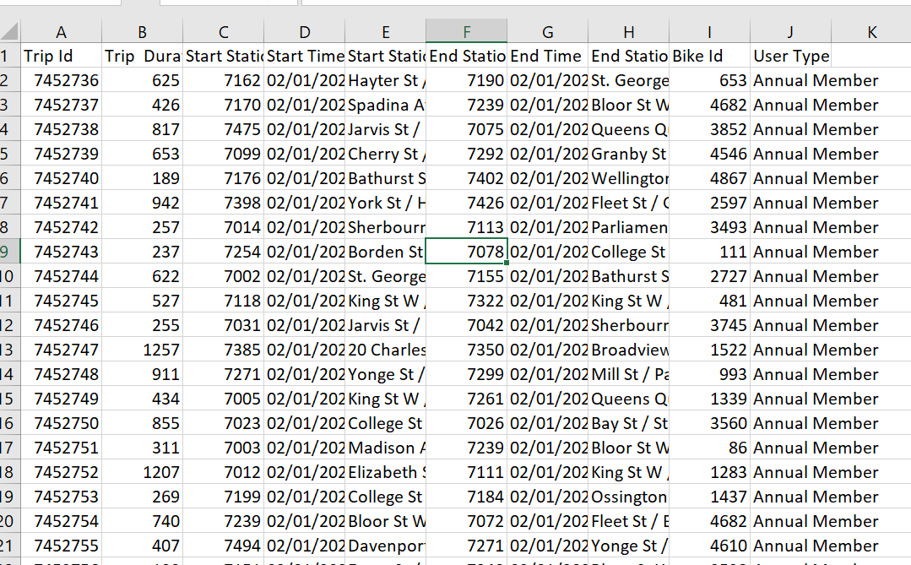
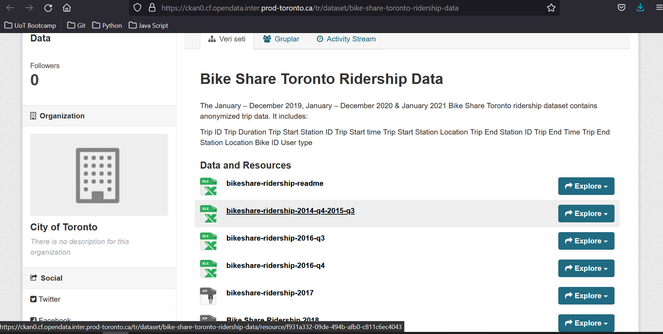
Data Extraction- Bike Data

Slide 7
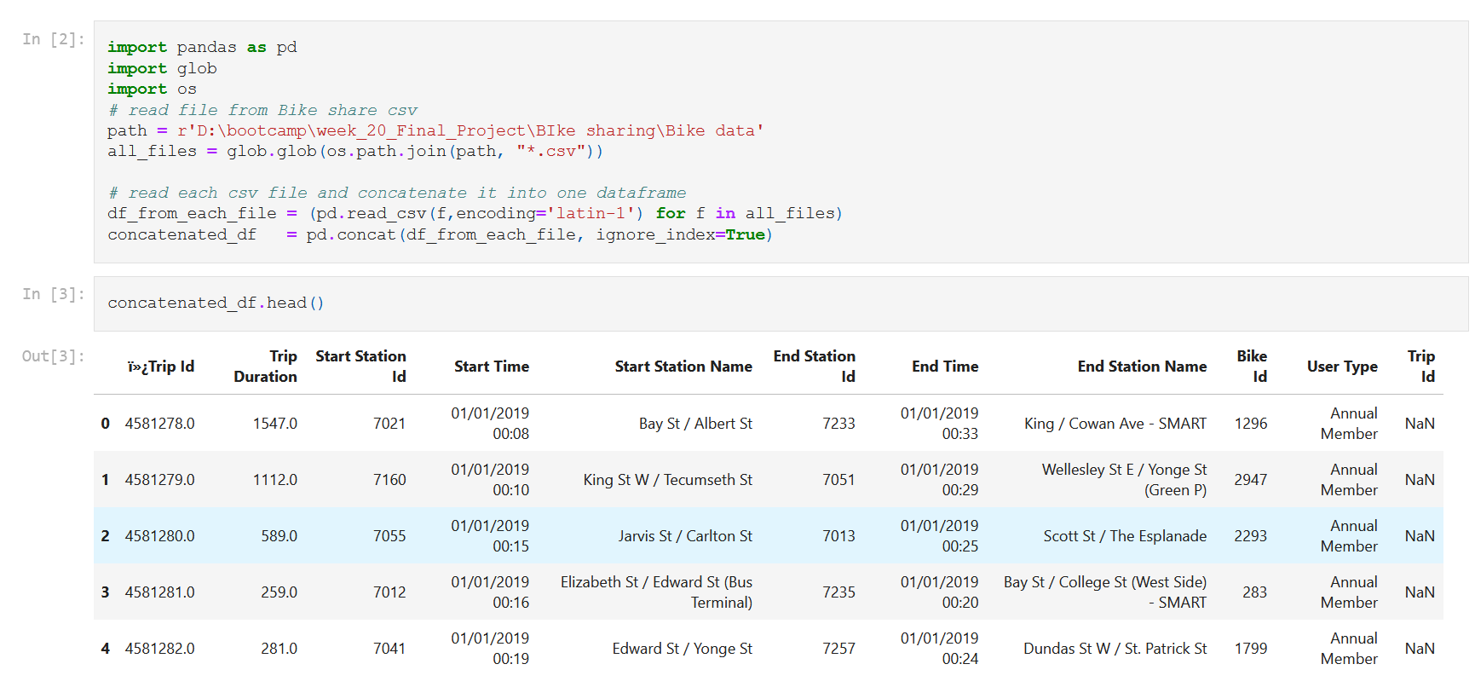
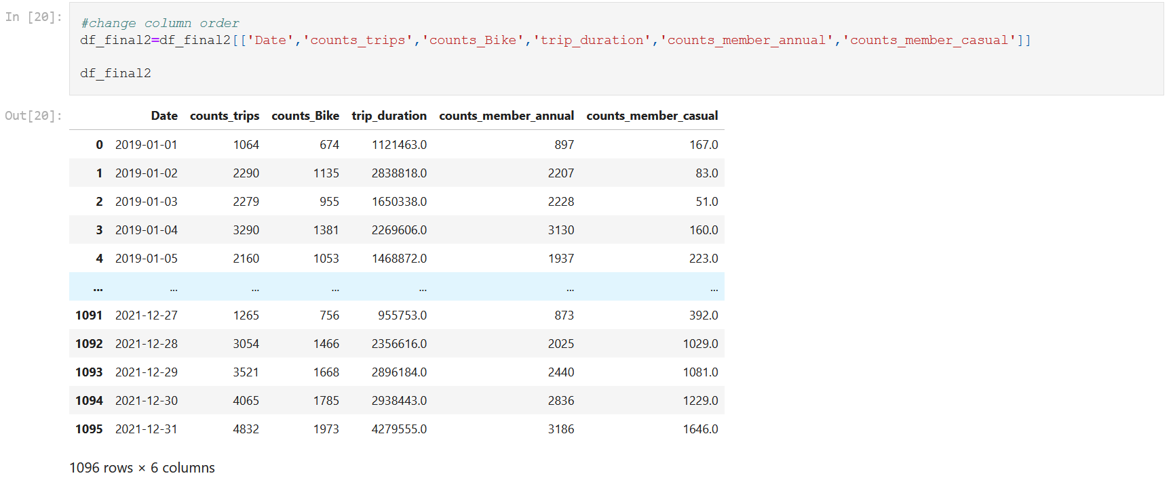
Data Cleaning- Bike Data
- Combine All CSV
- Count bike
- Sum Trip Duration
- Count Member Annual
- Count Member Casual

Slide 8
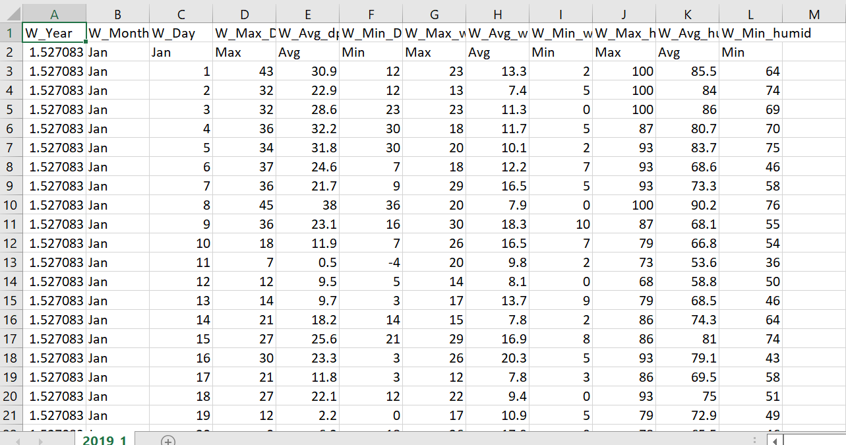
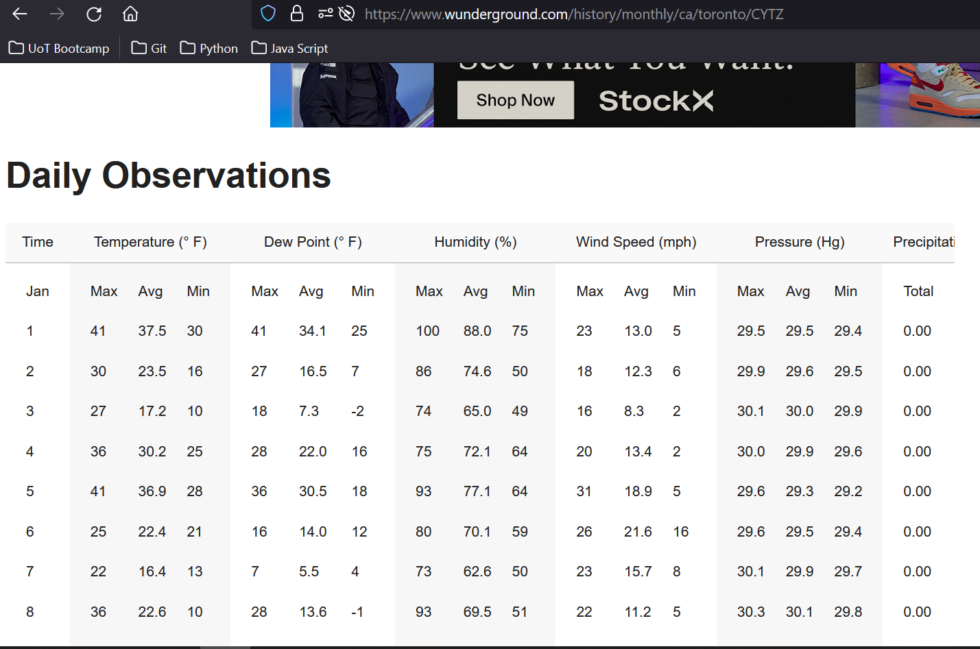
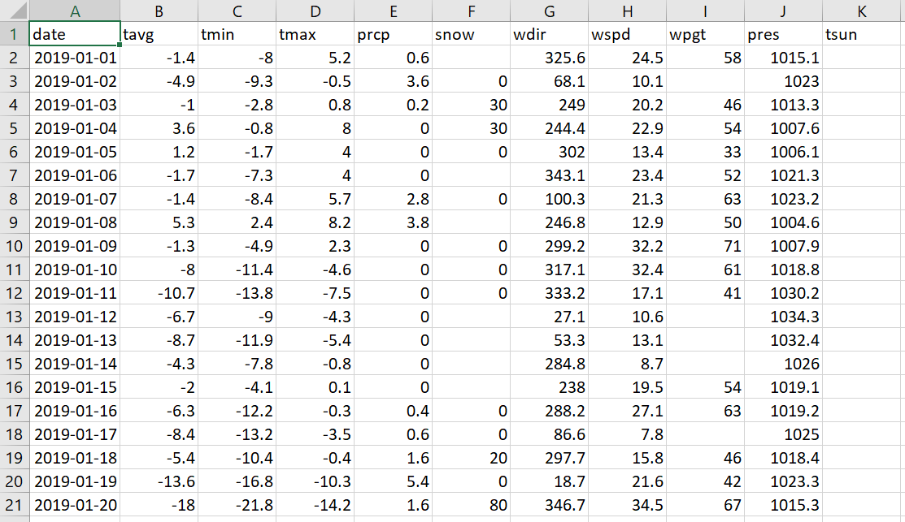
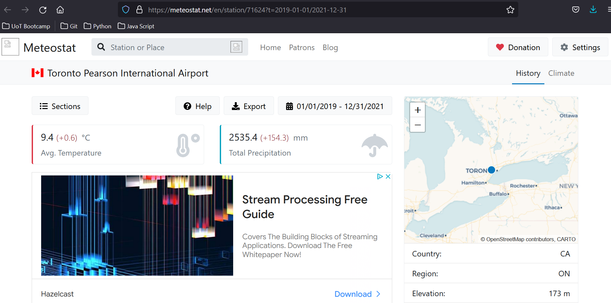
Data Extraction- Weather Data
SCRAPE FROM WEB

Slide 9
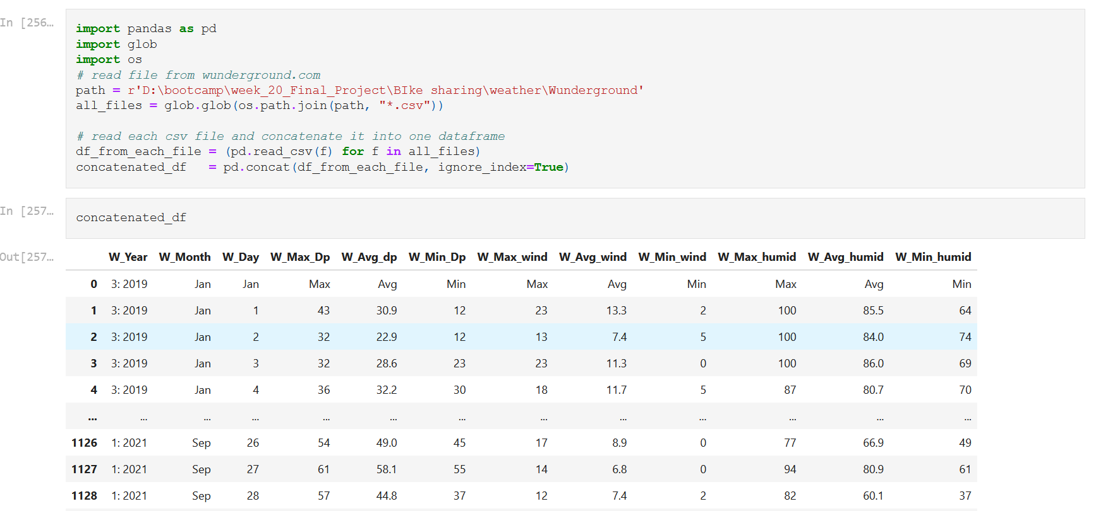
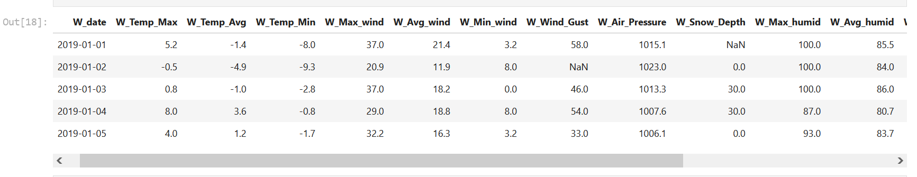
Data Cleaning- Weather Data
Combine CSV for result from scraping
Change Date format
Change Metric
Drop unnecessary column
Merge two data set with Date as key

Slide 10
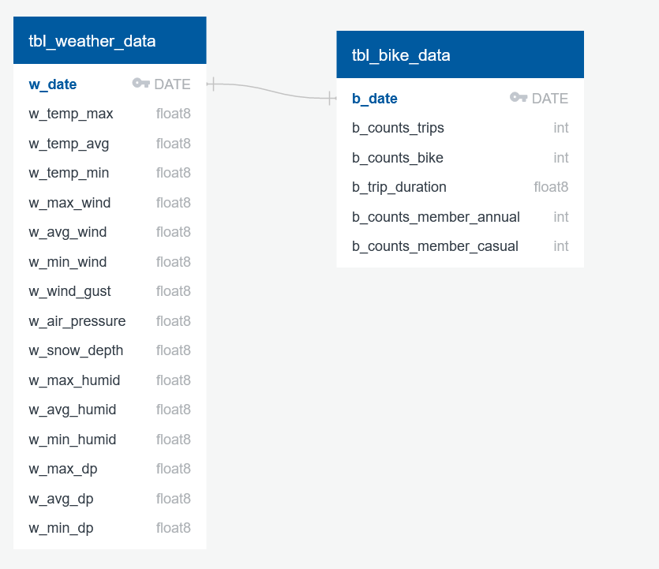
Entity Relationship Diagram

Slide 11
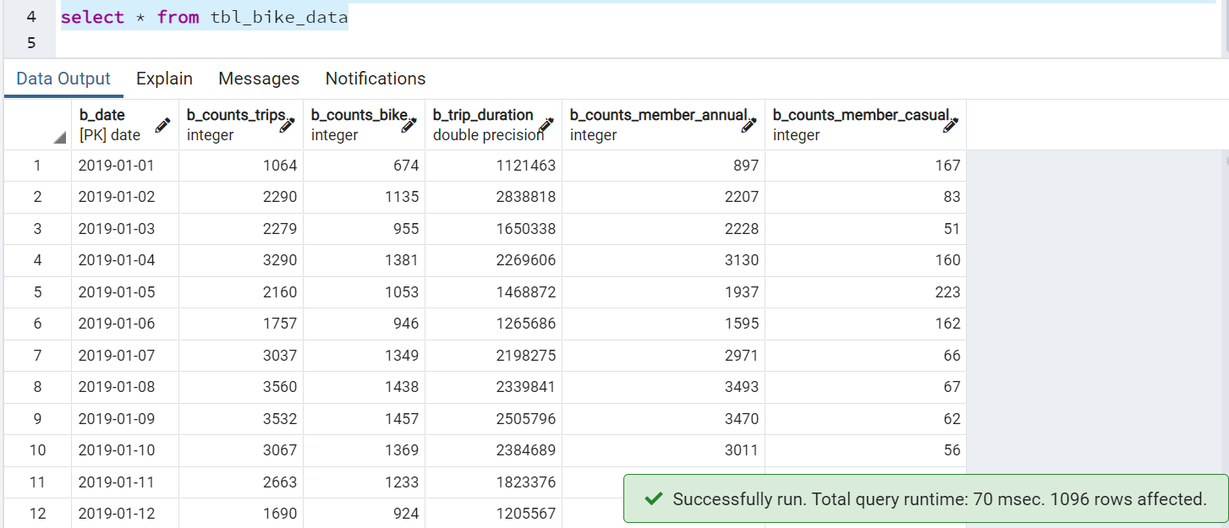
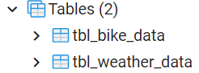
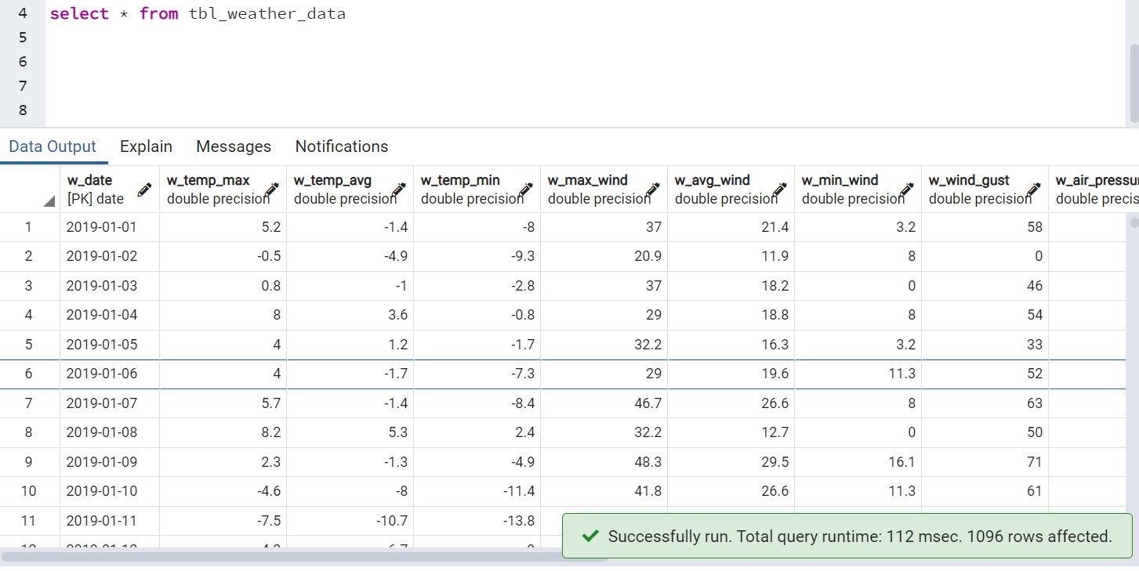
Database

Slide 12
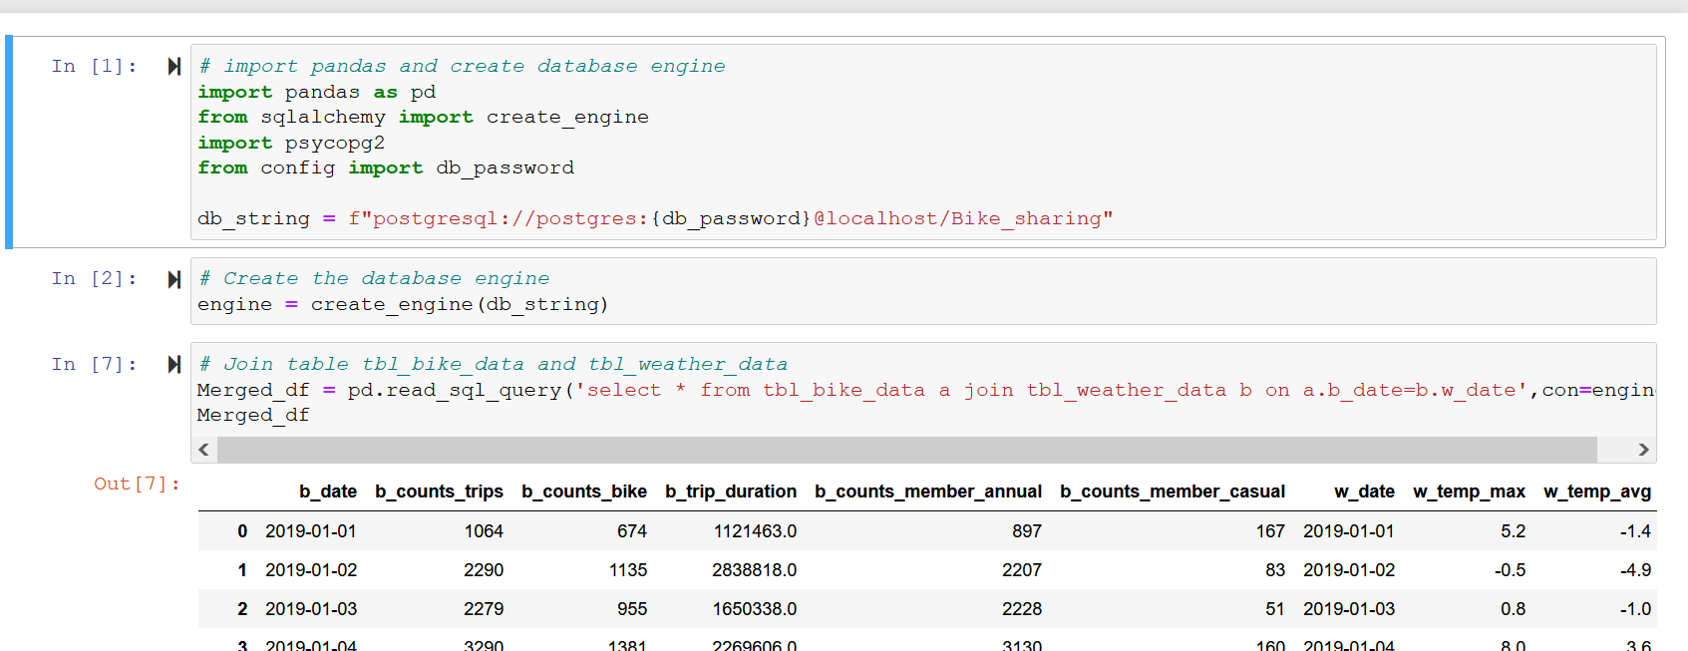
Connection to Machine Learning

Slide 13
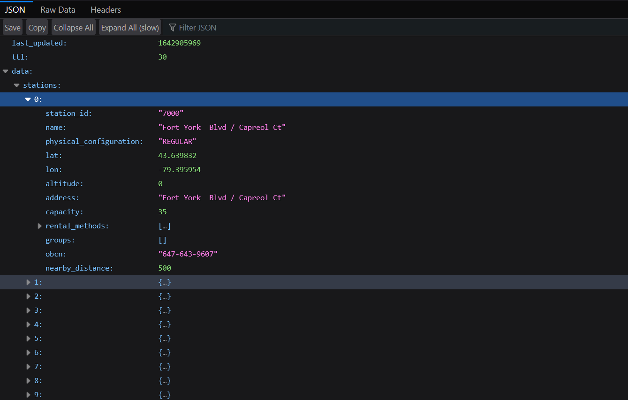
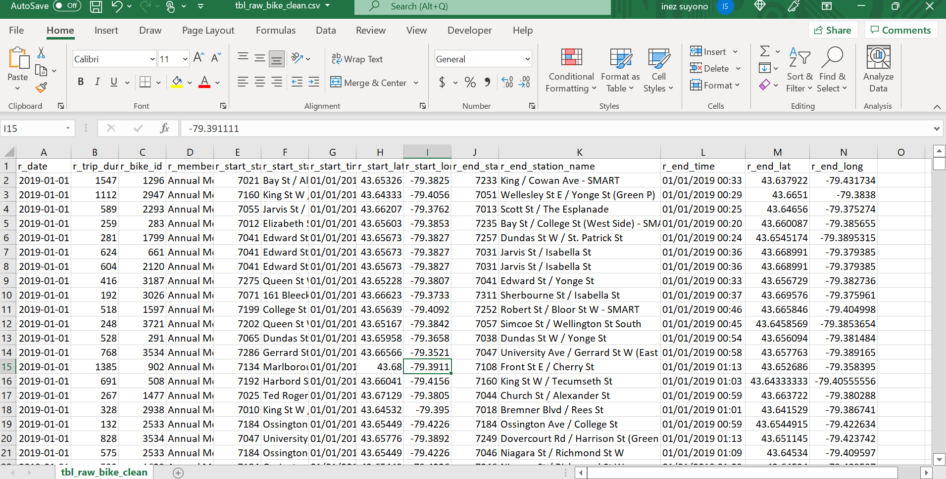
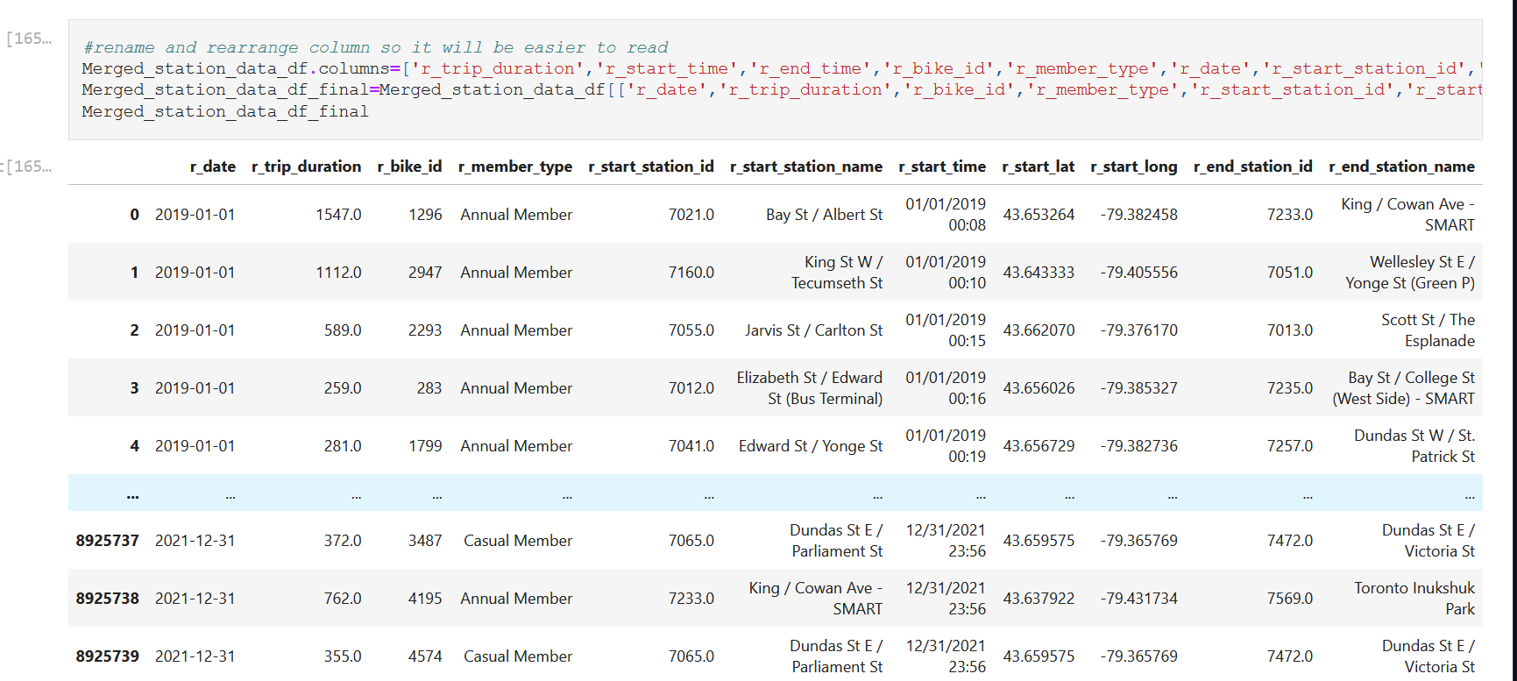
Additional Data for Visualization

Slide 14

Machine Learning

Slide 15
Machine Learning Model
Linear Regression
MODEL
Random Forest

Slide 16
Feature(s)
Average Temp
Trip Duration
Average Wind Speed
Independent Features
Wind Gust
Possible Outcome
Count Bikes
Air Pressure
Count Trips
Snow Depth
Average Humidity
Average Dew Point

Slide 17
Preliminary Features Selection Linear Regression
R²=66.16%
R²=75.84%
R²=66.16%
MAE:2898617.81
MSE: 19112705117582.13
RMSE: 4371807.99
Overall Model Score: 60.98%
MAE: 433.93
MSE: 284447.26
RMSE: 533.34
Overall Model Score: 75.02%
MAE:2898617.81
MSE: 19112705117582.13
RMSE: 4371807.99
Overall Model Score: 60.98%
y: Trip Duration
X: avg_temp, avg_wind, wind_gust, air_pressure, snow, avg_humid, avg_dp
y: Count Bikes
X: avg_temp, avg_wind, wind_gust, air_pressure, snow, avg_humid, avg_dp
y: Count Trips
X: avg_temp, avg_wind, wind_gust, air_pressure, snow, avg_humid, avg_dp

Slide 18
Preliminary Features Selection Random Forest
R²=95.02%
R²=96.38%
R²=95.02%
MAE: 11048141.50
MSE: 2810649367460.8
RMSE:1676499.14
Overall model score: 62.84%
MAE: 160.38
MSE: 42654.64
RMSE:206.53
Overall model score: 78.48%
MAE: 11048141.50
MSE: 2810649367460.8
RMSE:1676499.14
Overall model score: 62.84%
y: Trip Duration
X: avg_temp, avg_wind, wind_gust, air_pressure, snow, avg_humid, avg_dp
y: Count Bikes
X: avg_temp, avg_wind, wind_gust, air_pressure, snow, avg_humid, avg_dp
y: Count Trips
X: avg_temp, avg_wind, wind_gust, air_pressure, snow, avg_humid, avg_dp

Slide 19

Visualization

Slide 20
Tableau
Annual Member and Casual Member
Average Trip Duration by Year
Weather Temperature
LINK :
Annual Members
https://public.tableau.com/app/profile/ivan4393/viz/Dashboard_16428543063150/Story1?publish=yes

Slide 21
Tableau
Top Starting Station
Member Type
Average Trip Duration
LINK :
https://public.tableau.com/app/profile/ivan4393/viz/ProjectRawData/Story1?publish=yes

Slide 22
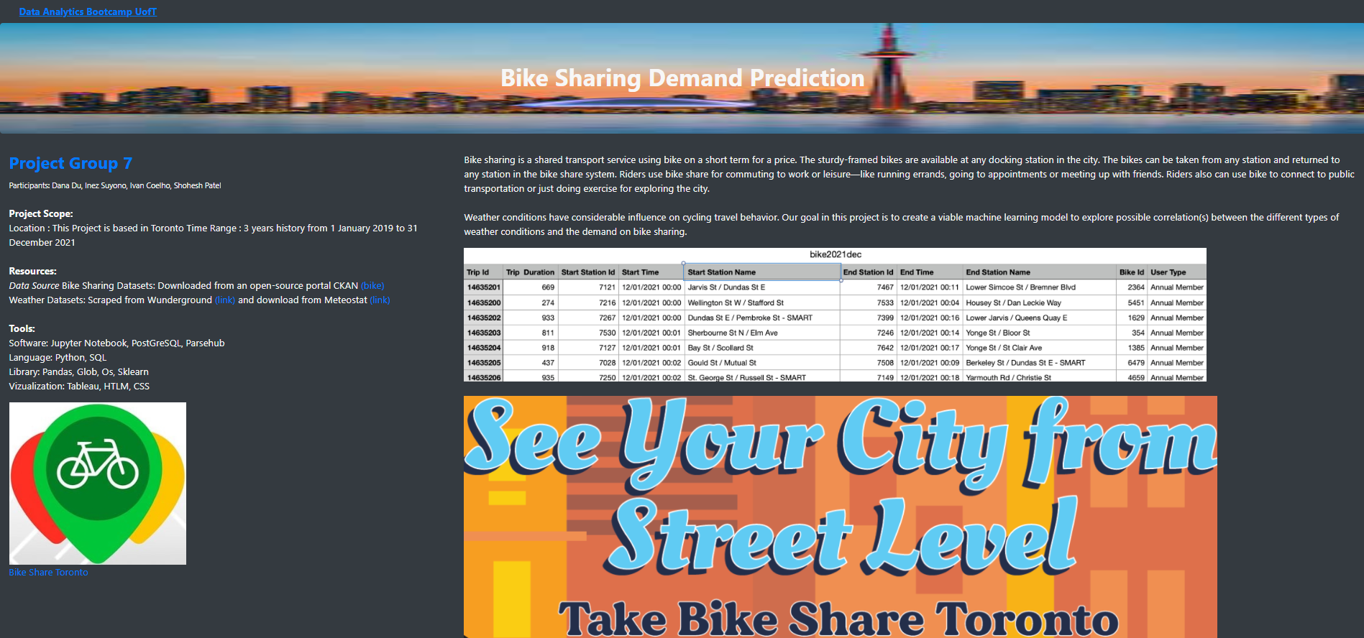
Website

